Slide 1

December 12, 2019
Wi-Fi: 1393Conference
Password: kayla1393

Slide 2

Welcome & Introductions
Your name
Your organization
Your mission
Your connection to population health
www.lihealthcollab.org

Slide 3
PHIP- A Refresher
Long Island’s
Population Health
Improvement Program
www.lihealthcollab.org

Slide 4
What is a PHIP?
Region-wide entity coordinating and supporting public health initiatives for all populations
Bring diverse partners to the table to tackle stubborn health issues
Funded by a NYSDOH grant to service 11 regions in the state
Long Island Health Collaborative is contractor for LI region
Work guided by the state’s Prevention Agenda (PA)
  PA’s overarching goal is to improve health – neighborhood by neighborhood – legislative district by legislative district
  Two priorities chosen via data findings and group’s consensus
www.lihealthcollab.org

Slide 5
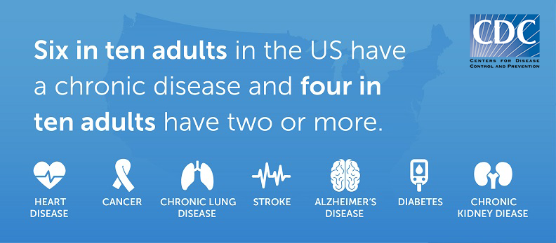
Our Priorities
Reducing incidence of chronic disease
Tackling mental health issues and substance use issues
Encouraging Lifestyle Change
Through the promotion of
Nutrition and Physical Activity
And the education surrounding
Social Determinants of Health**
**
One of the greatest challenges to high-impact interventions is the difficulty in navigating and coordinating fragmented and complex programs aimed at addressing healthcare needs, food insecurity, housing instability, workforce supports, transportation reliability, and more.
www.lihealthcollab.org
Notes:
Many mental health issues, such as depression and anxiety, are chronic conditions, as are the more serious mental health illnesses – such as bipolar disorder and schizophrenia. There is no sound physical health without sound mental health and vice versa.
Nutrition and physical activity – these two components have the most bearing upon chronic disease. Abundant evidence and research exists confirming that lifestyle changes in these areas can significantly improve and/or prevent chronic diseases and ensuing complications. We also know that without sound mental health, there is no good physical health.

Slide 6
Investment Shows Results
Annual award $600,000
LIHC collects and analyzes hyper-local data
Drives health planning and resource allocation for programming
Informs CHNA counties and hospitals required to conduct
  Service worth about $1.2 million in savings to region, leaves more money for other regional health planning needs
Our data analyses show
  Long Islanders’ consumption of fruit is improving
  Long Islanders’ physical activity levels show slight uptick
Collaborative members work in their own way to achieve improvements
  Saves the region millions in healthcare costs via avoidable hospital ED visits
  Improves individuals’ quality of life, work productivity, civic engagement
www.lihealthcollab.org
Notes:
Understanding that all healthcare is local – meaning every community, every neighborhood looks different and has its own unique health issues and challenges – requires an ability to look at data from a hyperlocal perspective. LIHC is able to do this via its primary collection tools – Community Health Assessment Survey – and the qualitative data collected via summits/focus groups, etc. On the flip side, all chronic disease drivers are universal – meaning that lifestyle choices – specifically food choices and access and physical activity levels – play a disproportionate role in health outcomes, chronic disease incidence.

Slide 7
Our Initiatives
Long Island “Healthy Libraries” interactive programming map
Walk with a Doc
Are You Ready, Feet?
Cultural Competency and Health Literacy (CCHL)
Networking opportunities
Long Island Community Health Assessment Survey
Data aggregation and analysis
www.lihealthcollab.org

Slide 8
Toward Our Future
A promotional and data resource for the dozens of initiatives related to mental health and substance use disorders impacting Long Island
Raising awareness about need for self-management of chronic disease through public outreach campaign
New York State ranks second among states in medical expenditures attributable to obesity at $11.1 billion – (NYS BRFSS analysis)
Produce thematic data reports – October 2019: Adult Alcohol Abuse
Assessing individuals’ and communities’ perceptions about health/social needs and barriers through Community Health Assessment Survey
www.lihealthcollab.org

Slide 9

Solutions and Takeaways
Funded by the state’s PHIP, the Long Island Health Collaborative is,
a data resource organizer and analyzer
the core of population health coordination
a constituent connector
Through solutions-oriented approaches, we serve to
Follow collective impact model
Leverage diverse partners
Foster linkages
Promote VBP concept
Eliminate redundancies
Streamline practices
Aggregate data
www.lihealthcollab.org
Notes:
The LIHC operates from a solutions-oriented approach. That means helping organizations identify partners with whom they can collaborate to bring about the greatest change - cost efficiently and effectively. True to the collective impact model, the LIHC is the backbone organization providing LIHC participants with the data, administrative support, and networking base to get the job done. Looking further down the road, we are also mindful of the powerful presence VBP contracting has and will continue to have, as the state’s healthcare delivery system continues to transform from volume to value. Our data analysis capabilities and reports will play a key role in ensuring that hospitals and organizations of every type and size have a meaningful and sustainable role in healthcare/social services delivery.

Slide 10

Featured Presentation
Carter Strickland
New York and New Jersey State Director
The Trust for Public Land
carter.strickland@tpl.org
www.lihealthcollab.org

Slide 11


Long Island Greenway
Prepared for
September 2019

Slide 12
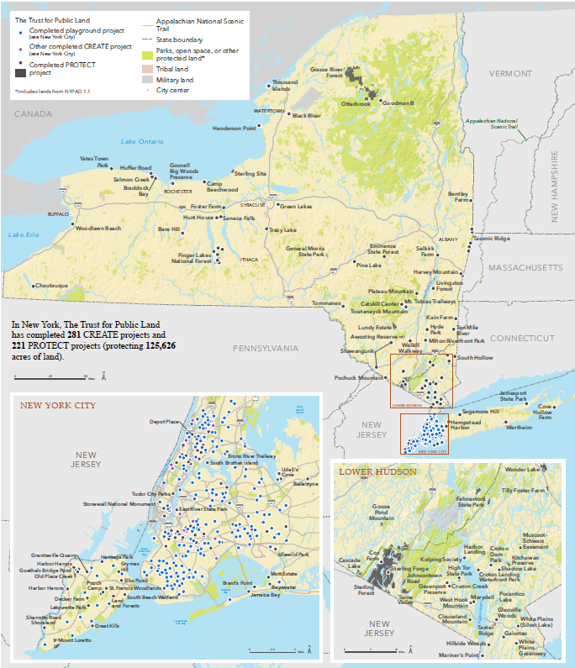
40 Years of Work for New York
Communities
1978: Started working for New York communities
125,000+ acres protected
200+ playgrounds and parks created
70+ community gardens protected
4+ million people within a 10-minute walk
2

Slide 13
Prevention Agenda 2019-2024
Focus Area 2. Physical Activity
Goals
Reduce obesity and the risk of chronic diseases
Improve community environments that support active transportation and recreational physical activity for people of all ages and abilities.
Promote school, child care and worksite environments that increase physical activity
Increase access, for people of all ages and abilities, to indoor and/or outdoor places for physical activity.
Objectives: By 12/31/24
Increase participation in leisure-time physical activity
Increase walking or biking
Increase physical activity
Interventions
improved pedestrian, bicycle, or transit transportation system components (i.e., activity-friendly routes):
3

Slide 14
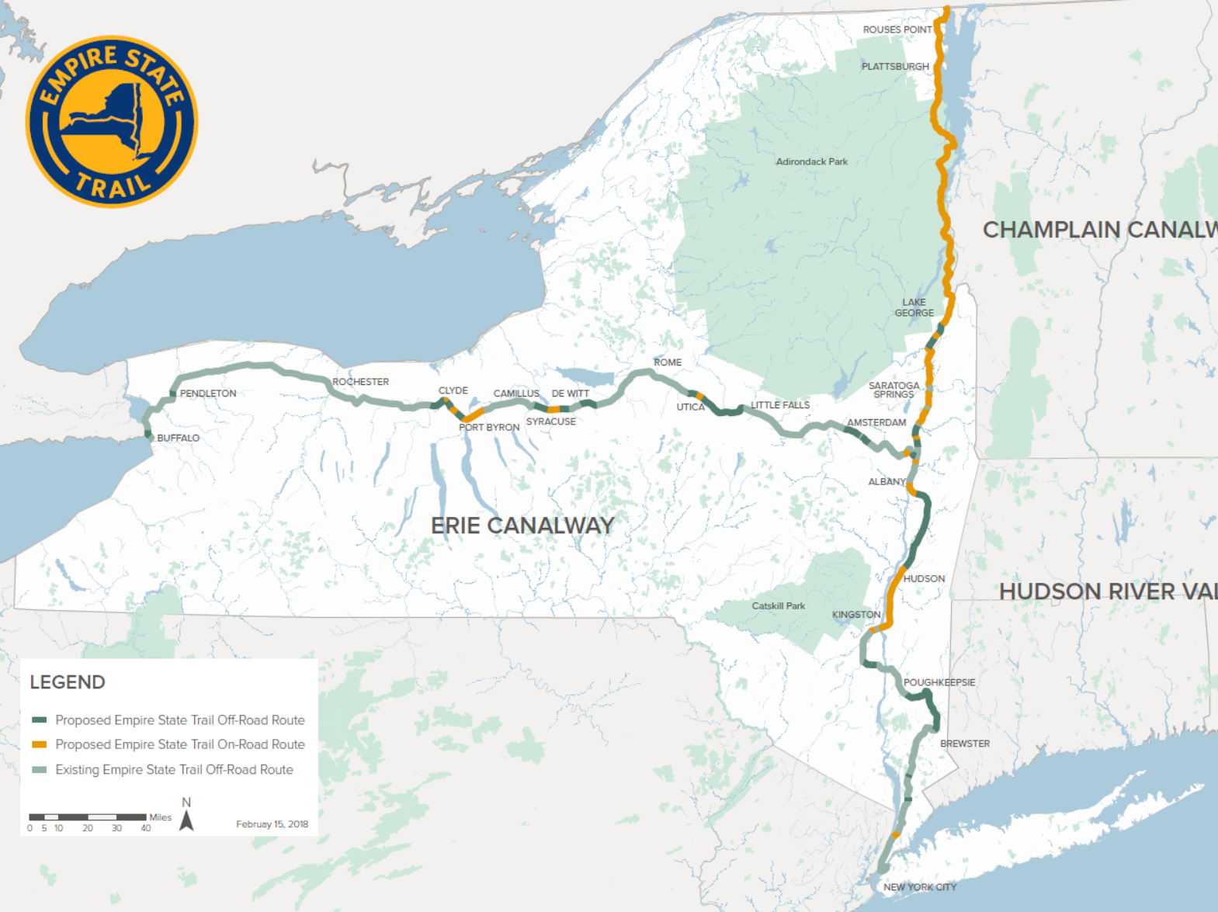
Empire State Trail
The Empire State Trail (EST) is a 750-mile trail connecting Buffalo, Plattsburgh, and NYC.
Leverages the high-growth outdoor recreation industry in New York:
  $41.8 billion in consumer spending
  313,000 direct jobs (4th highest sector)
  $14 billion in wages and salaries (10th highest)
  $3.6 billion in state and local tax revenue.
Long Island is not yet included in the EST, but there is a strong groundswell of support for an extension.
4

Slide 15


Long Island’s Future
Vision: sustainable and equitable 21st century suburb
Attract and retain young professionals with amenities comparable with any major city and by solidifying the strong “sense of place” across the Island
Revitalize downtown areas with walkable communities and affordable multifamily housing
Modernize and leverage the LIRR with other transportation modes, and divert car trips to transit
Connect more Long Island neighborhoods to coastal areas and parks with a network of accessible walking and biking trails
Fix pedestrian and bicyclist fatalities, which are significantly higher than in the rest of the State
5

Slide 16

Benefits for Long Island
Extending the Empire State Trail across Long Island would put it in the backyards of the 7 million people who live in Kings, Queens, Nassau, and Suffolk Counties, and would provide many benefits.
Promote Community Vitality: The proposed route will take advantage of Long Island’s unique parks and cultural resources to promote active recreation and tourism.
Increase Connectivity: The proposed route will serve as a transportation resource, connecting communities as well as existing trails throughout Long Island
Foster Equity & Public Health: The proposed route will be accessible to all users, and promote positive health outcomes via active recreation/transportation
6

Slide 17
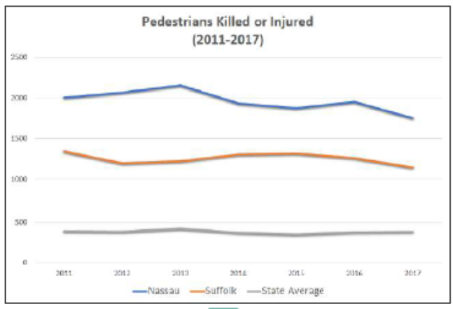
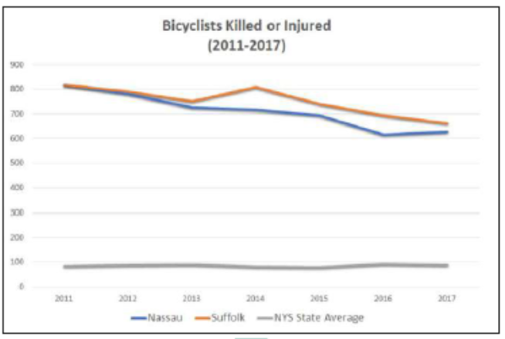
Safety on Long Island
7

Slide 18
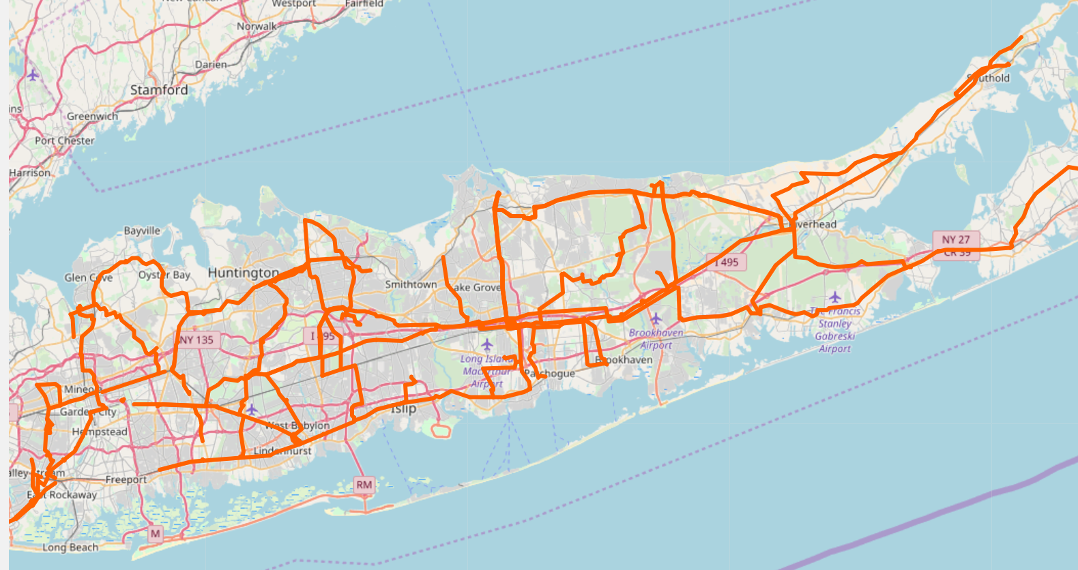
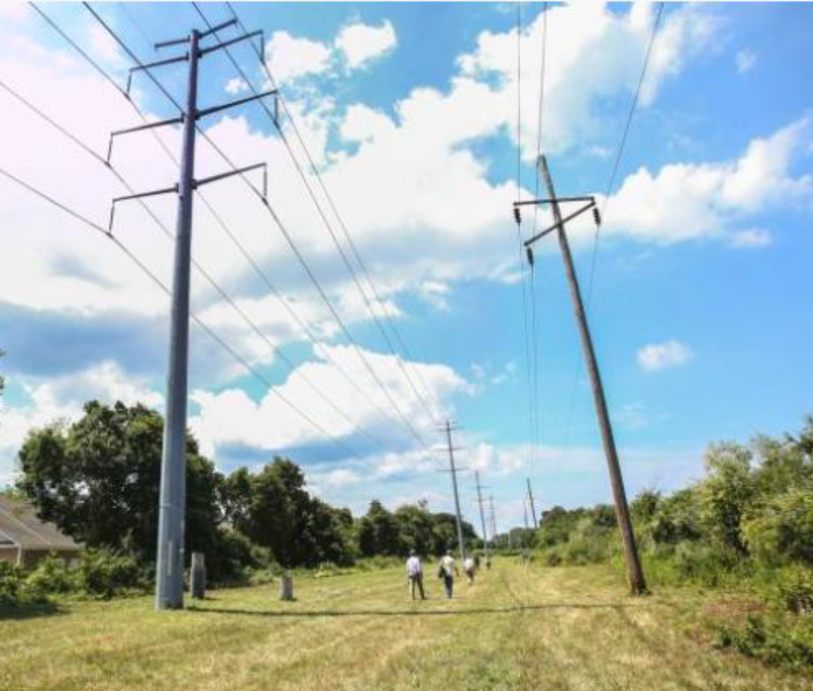
Opportunity: Utility Corridors
8

Slide 19
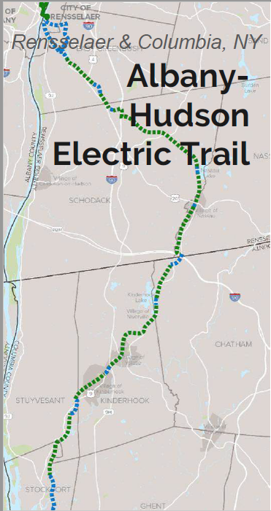

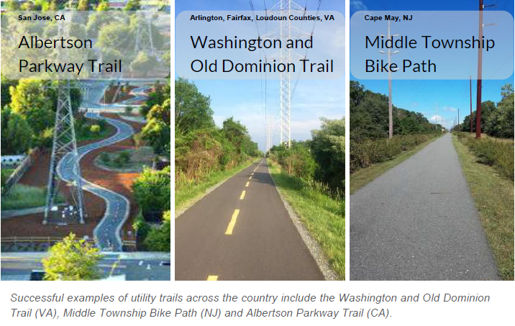
Utility Line Trails
9

Slide 20
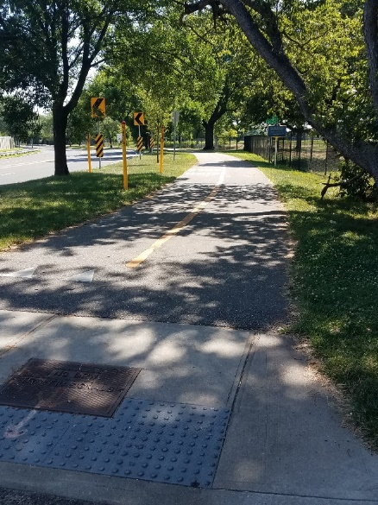
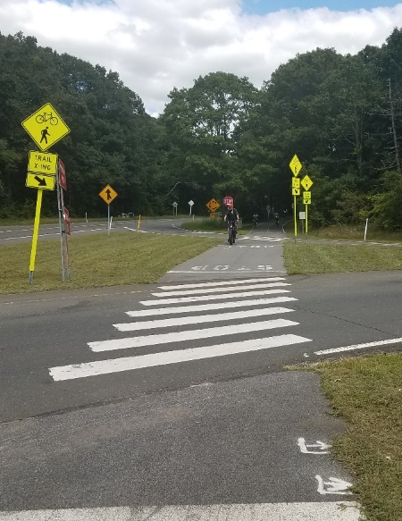
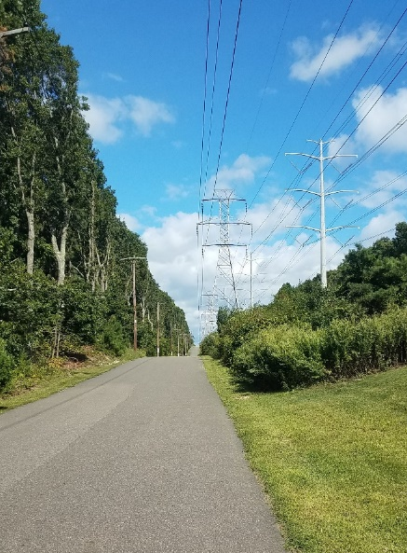
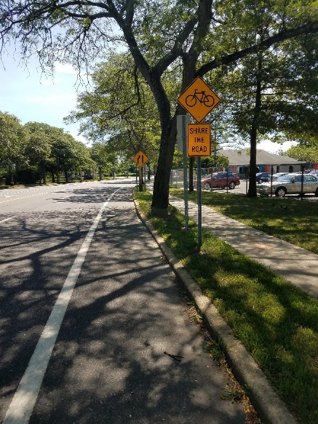
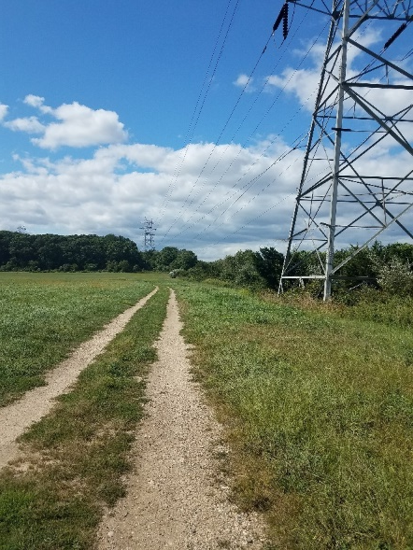
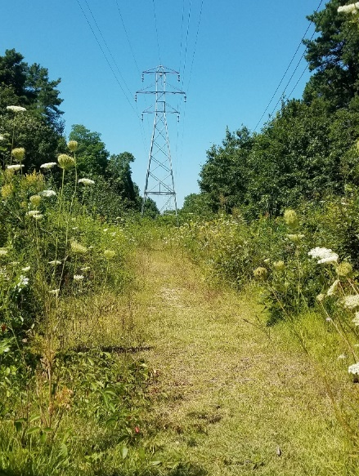
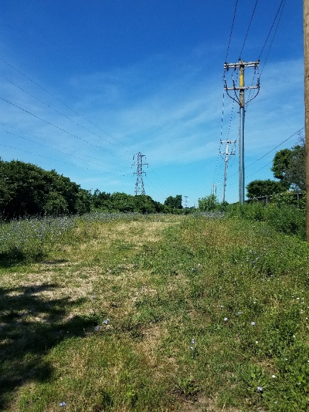
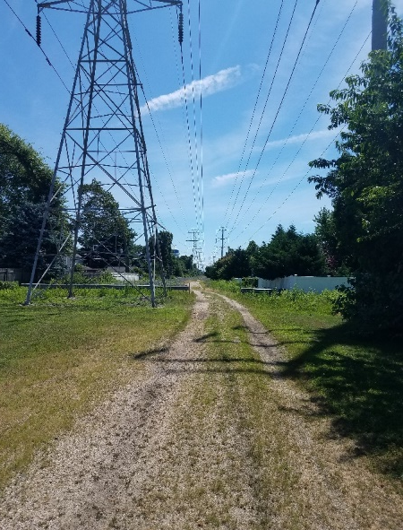
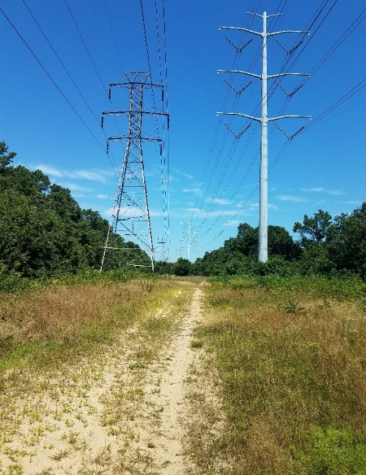
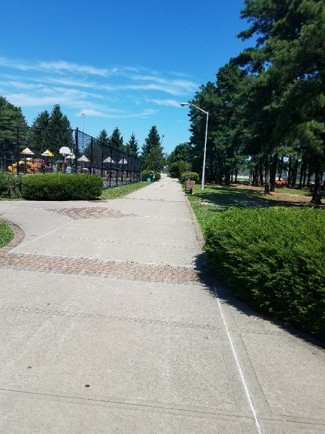
Ground-Level View
Eisenhower Park
East Meadow
Bethpage Bikeway
Melville
Melville
East Meadow
Levittown
Dix Hills
Ostego Park
Edgewood
10

Slide 21
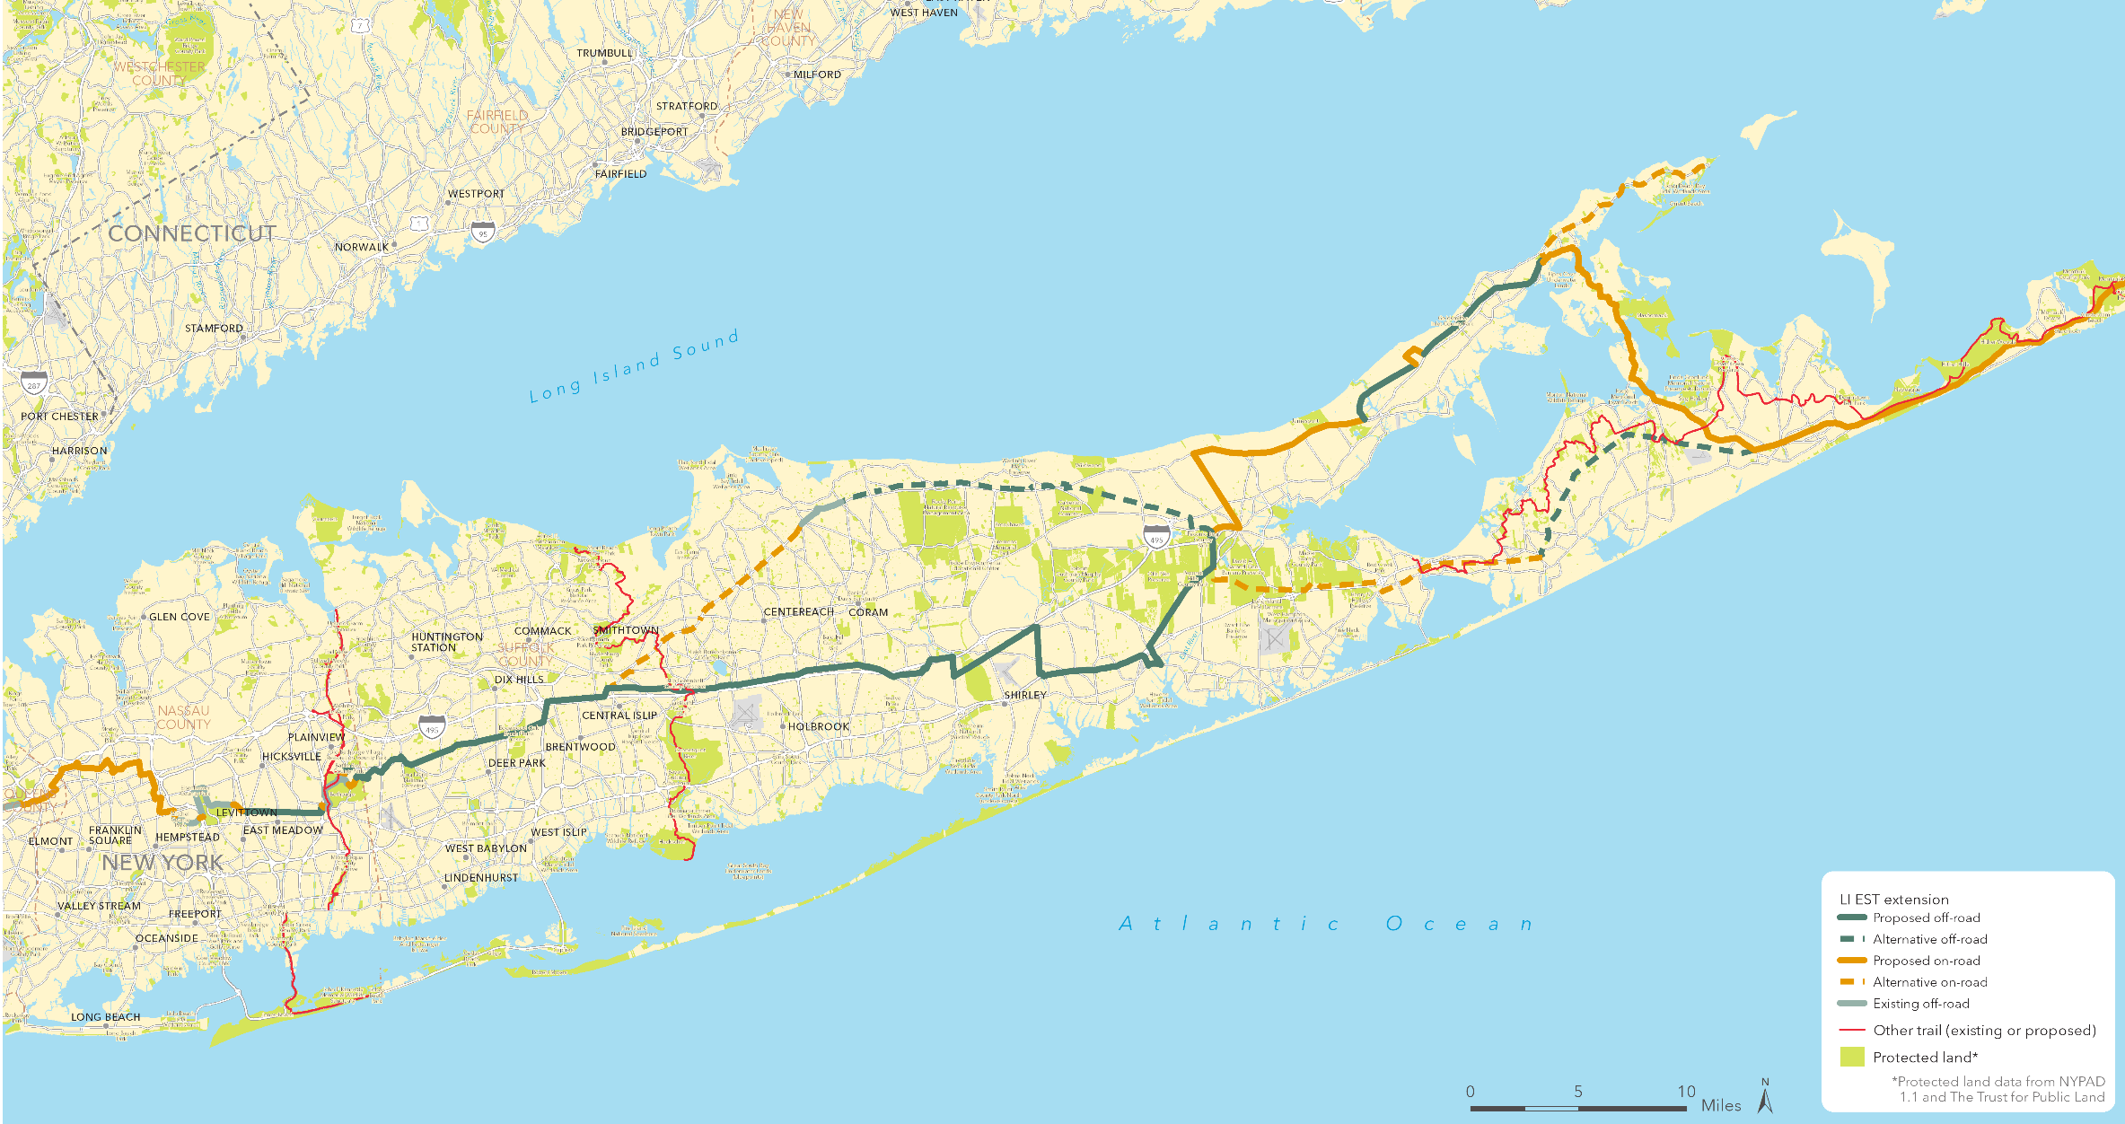
175-Mile Connector
11

Slide 22
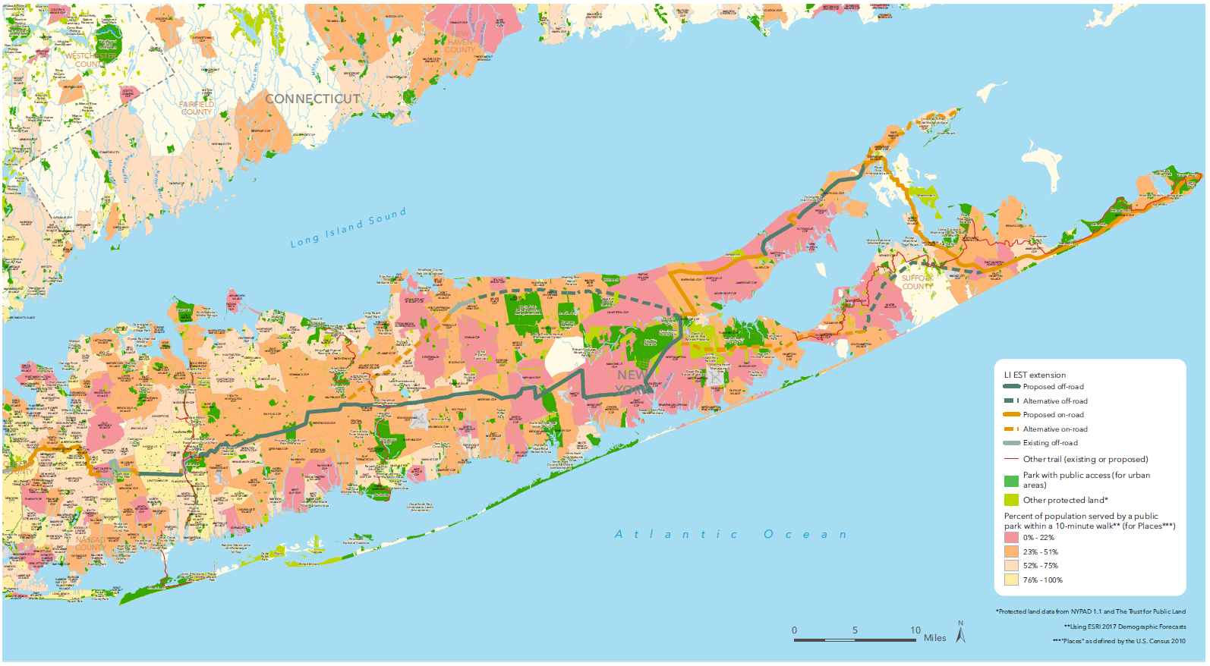
Park Equity
12

Slide 23
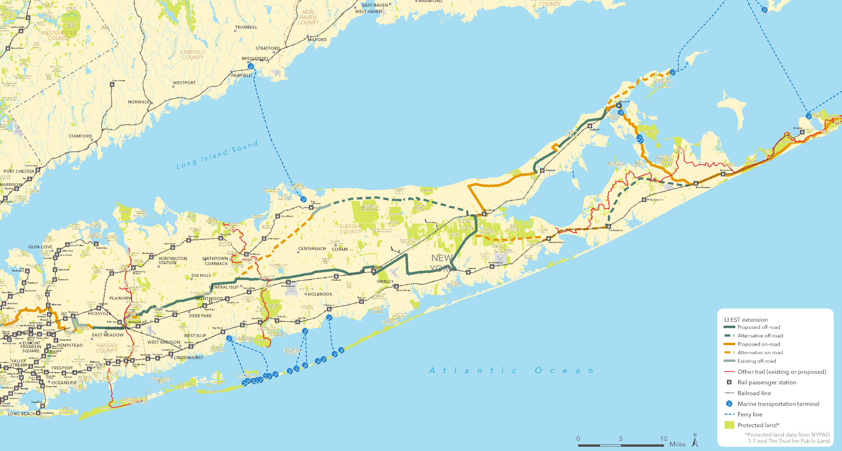
Transit Connectivity
13

Slide 24
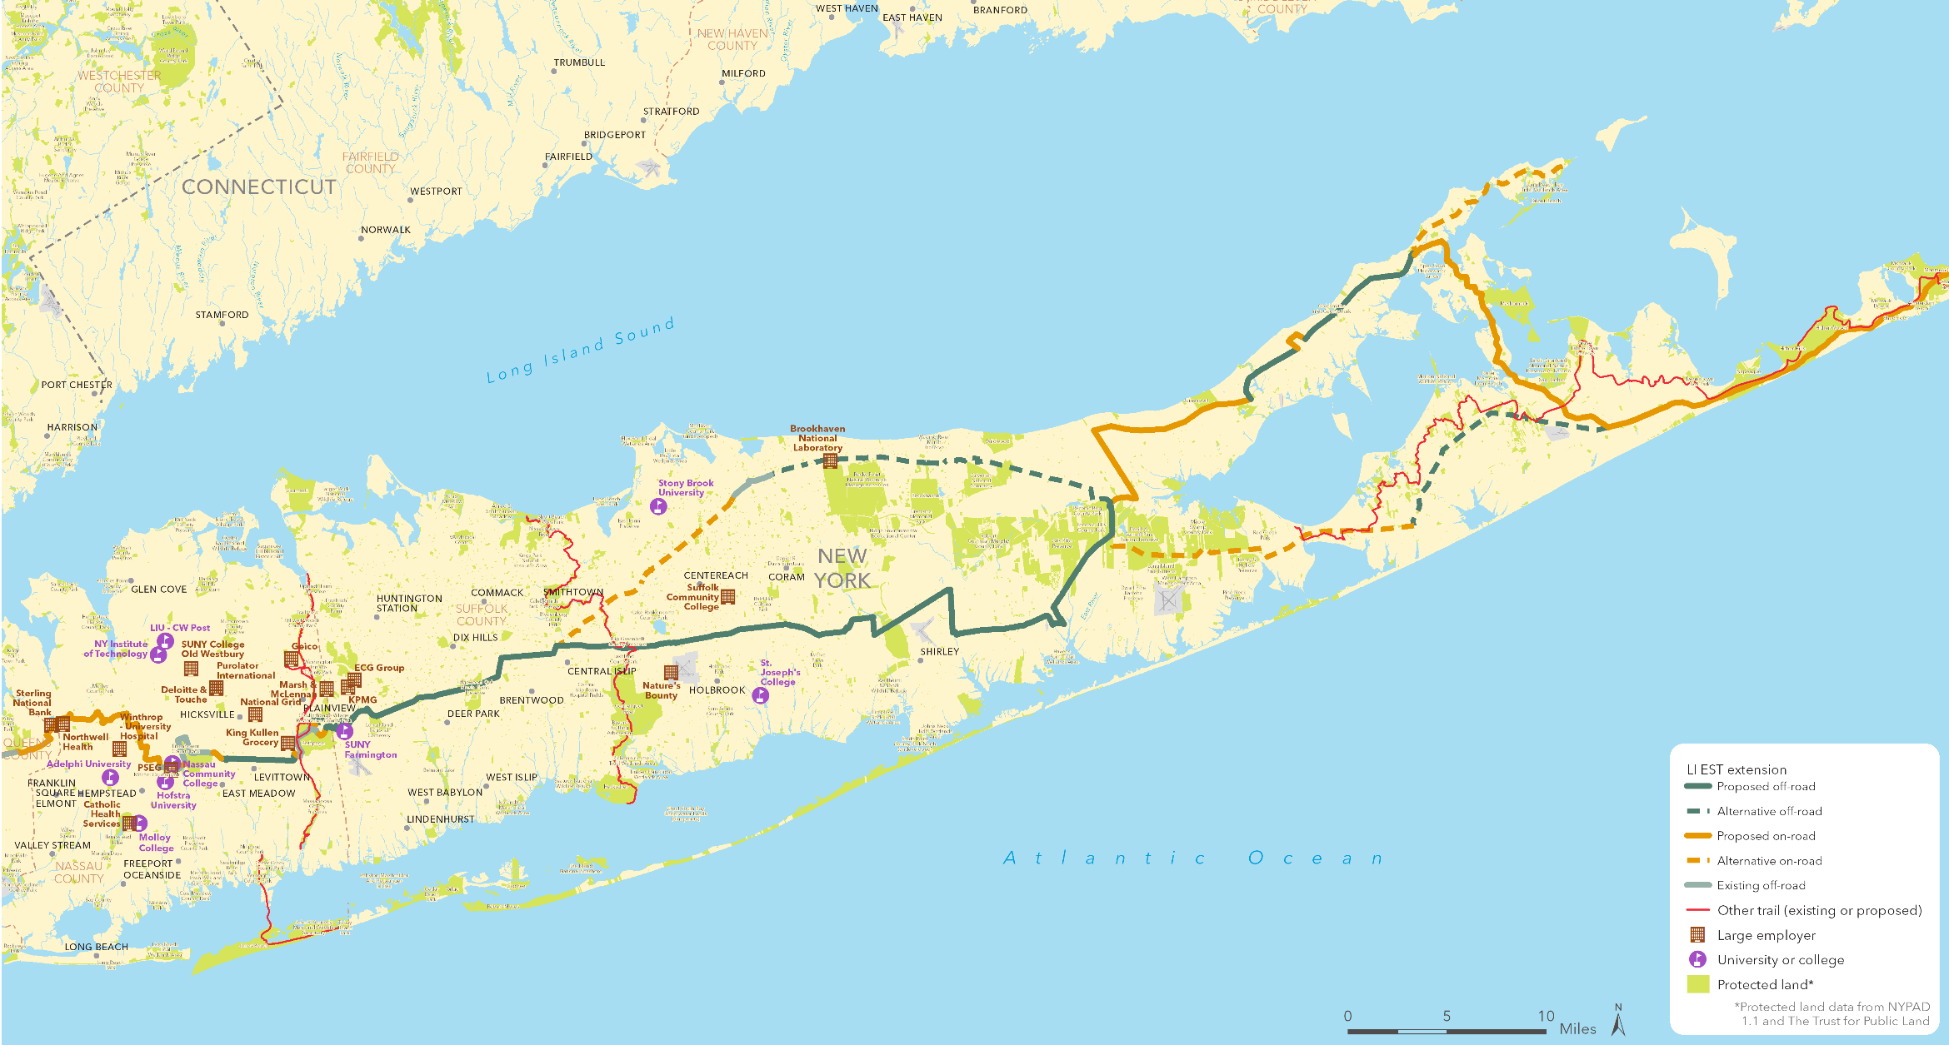
Business & University Connectivity
14

Slide 25

Synergy with Redevelopment Areas
Downtown Revitalization Initiative
Nassau Hub
Hauppauge Industrial Area
Belmont
15

Slide 26
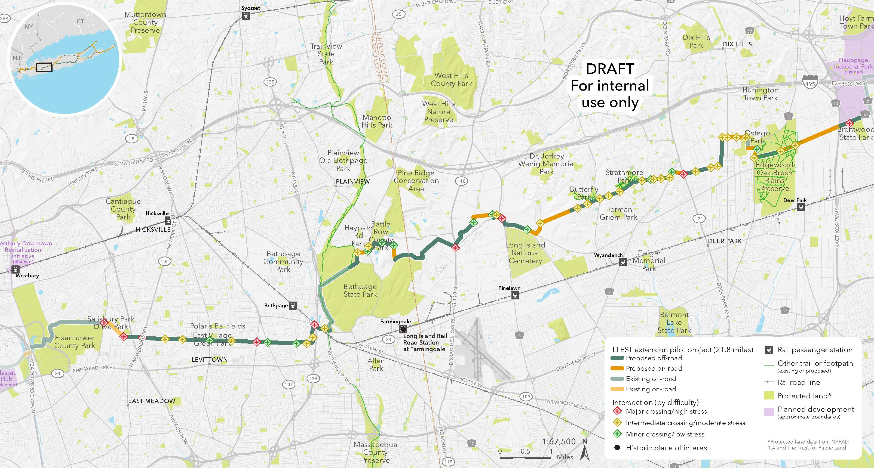
First Phase
16
Notes:
24 Miles
76% Off-Road
13+ Parks
9 Communities
104,000 Residents, 36 Schools within a one mile
3 Hubs with $2.4B investments
Communities
Bethpage
Brentwood
Dix Hills
East Meadow
Levittown
Melville
Old Bethpage
(could add Salisbury – goes along it)
Develoment Hubs
Westbury
Nassau
Hauupauge development hubs

Slide 27
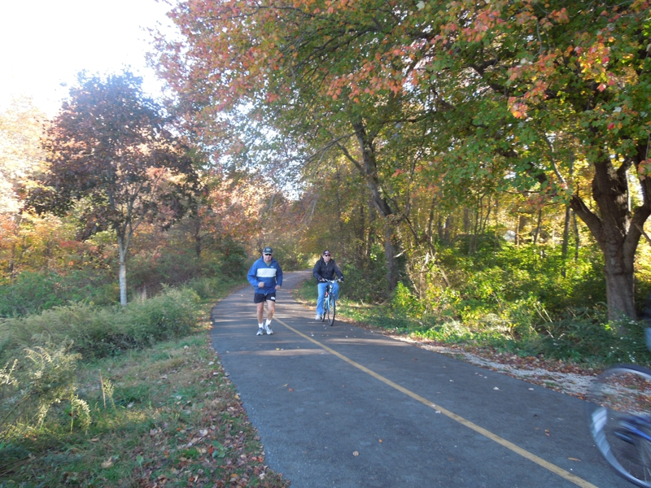
Timeline & Preliminary Cost Estimate
7
Empire Trail Extension Overall Feasibility Study completed, published at https://www.tpl.org/our-work/long-island-extension-empire-state-trail
State CFA grant award
Engineering and environmental studies
Design RFP for proposed pilot projects
Capital commitment in the NYS budget
Design and implementation of the recommended Long Island route
2018
2019
2020
2021
Ongoing
Proposed pilot segment Feasibility Study
Integration of the planned Long Island Extension route into the Empire State Trail
Pilot project design approval and initiation of construction
Planning level estimate is
$114 million
for design and construction of the proposed route in Nassau and Suffolk Counties
17
Notes:
Based on the awarded contract for $882,000 per mile for the 10-mile Port Jefferson to Wading River trail project in consultation with EST project managers working on the formal 2020 launch, and on the national average cost of $25,000 per mile for the on-road segments
Includes 20% margin for planning, and engineering.
Excludes on-road portions in Manhattan, Brooklyn and Queens, and existing trail segments in Nassau and Suffolk County.

Slide 28
Government and Civic Support
Erik Kulleseid, New York State Parks Commissioner
Rose Harvey, Former New York State Parks Commissioner
Andy Beers, Executive Director, Empire State Trail
Fred Thiele, New York State Assembly
Laura Curran, Nassau County Executive
Steve Bellone, Suffolk County Executive
Arnold Drucker, Nassau County Legislature
Kara Hahn, Suffolk County Legislature
Sarah Anker, Suffolk County Legislature
Tom Wright, Regional Plan Association
Kevin Law, Long Island Association
Dave Kapell, The Rauch Foundation
David Okorn, The Long Island Community Foundation
Meme Hanley, Land Trust Alliance
Mitch Pally, Long Island Builders Institute
Eric Alexander, Vision Long Island
Kristin Jarnagin, Discover Long Island
David Reisfield, Long Island Greenbelt Conference
Guy Jacobs, Nassau Hiking & Outdoor Club
Joe Martens, Alliance for Clean Energy New York
Mike Vitti, CLIMB
Denis Byrne, LIGHT
18

Slide 29
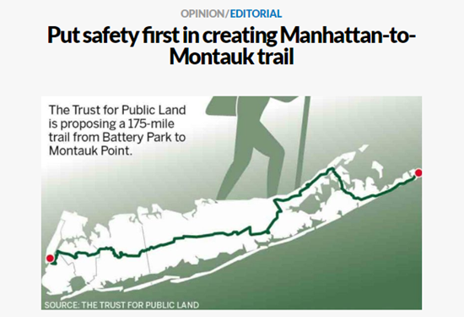
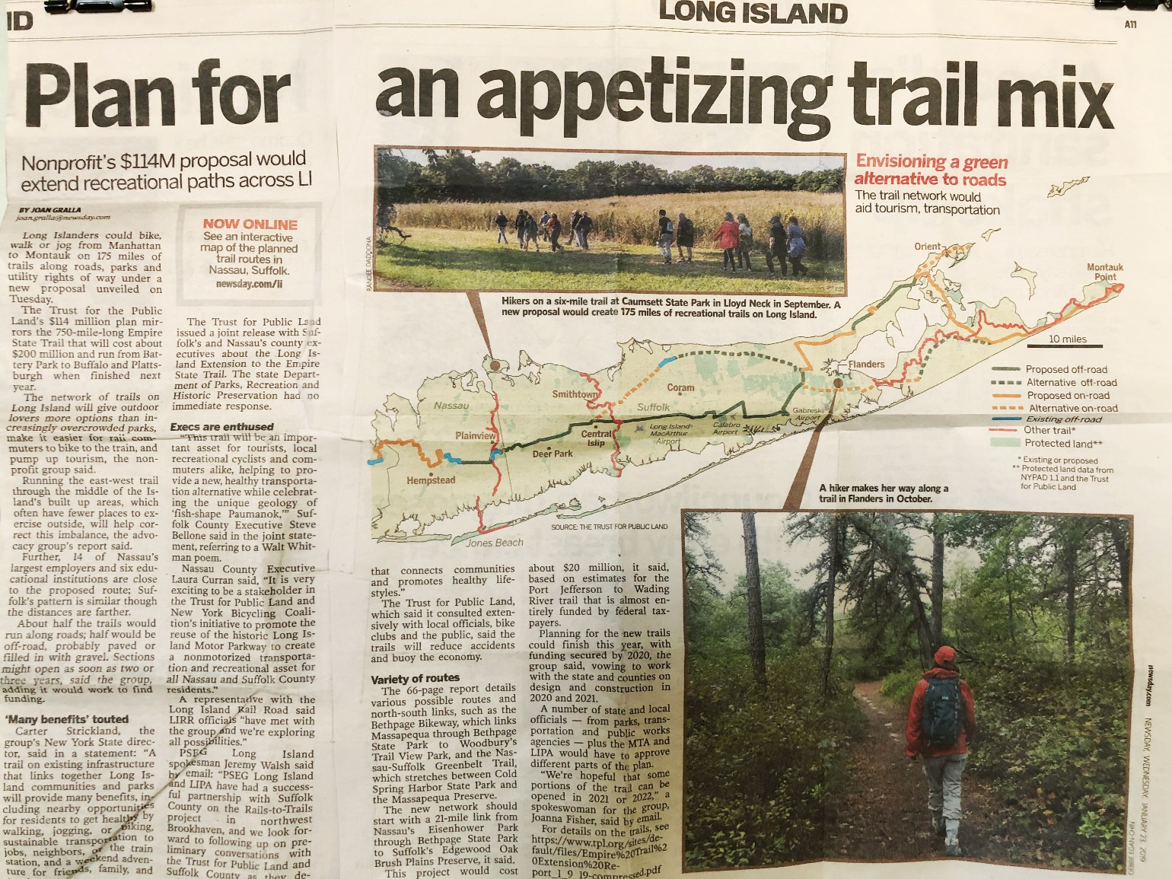
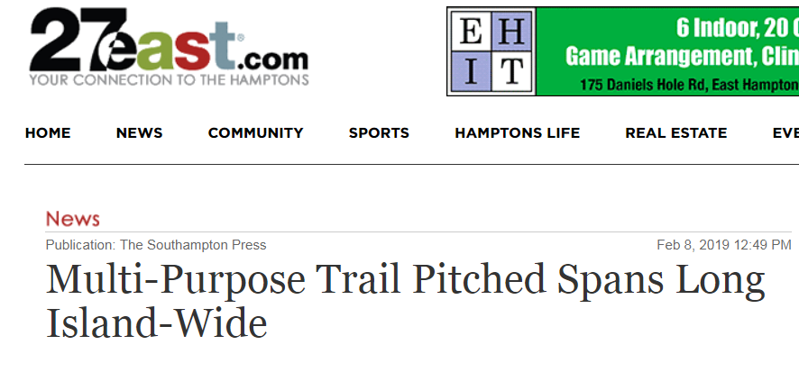

Growing Public Support
19

Slide 30




Thank You
Project Team
Trust for Public Land
Crater Strickland
Danny Gold
Grace Healy
Urban Cycling Solutions
Dan Suraci, AICP
Carter.Strickland@tpl.org | 212-574-6868
20

Slide 31

Northwell Health
Nancy Copperman, MS, RD, CDN
Representing Northwell Health
coppermannancy@gmail.com
www.lihealthcollab.org

Slide 32

Fidelis Care
Rodolfo Cano
Community Relations Specialist rcano@fideliscare.org
(516) 334-6588
www.lihealthcollab.org

Slide 33
Save the Date
Friday, February 28, 2020
Long Island Population Health Summit
In Partnership with the Long Island Association
More info coming soon!
www.lihealthcollab.org

Slide 34


Recognitions
Nancy Copperman,
MS, RD, CDN
Dr. James Tomarken,
MD, MPH, MBA, MSW

Slide 35
Data Resources
The LIHC is your data resource for
CSPs and CHIPs
For assistance, contact:
Janine Logan
(631) 963-4156
jlogan@nshc.org
www.lihealthcollab.org

Slide 36
Moving Forward
2020 Meeting Dates:
Wednesday, March 18
Wednesday, June 17
Thursday, September 17
Wednesday, December 9
LIHealthCollab.eventbrite.com
www.lihealthcollab.org

Slide 37
Adjournment
www.lihealthcollab.org
(631) 257-6957
info@lihealthcollab.org
www.lihealthcollab.org

